Slide 1

Data Management with AI and Python
Use ChatGPT and Python to enhance your ability to manipulate flood modeling and mapping data.
ASFPM 2025 Conference

Slide 2
What are Large Language Models
Large Language Models represent the pinnacle of generalized machine learning models invented to date.
By leveraging big data (all of the freely available written, image and video data on the internet) with increasing orders of magnitude of compute, increasing capabilities have been discovered.
LLM’s undergo pretraining, reinforcement learning, and post-training to achieve the desired instruction-following, tool use and reasoning capabilities.

Slide 3
LLM Providers and Platforms
Our Focus in This Workshop:
OpenAI Models:
ChatGPT 4o (base model)
ChatGPT o3 (with reasoning)
Anthropic: Claude 3.7
Google: Gemini 2.5 Pro
Anysphere: Cursor IDE
Honorable Mentions:
Perplexity.ai
Meta’s Llama Models
X.ai: Grok
Microsoft: Windows Copilot
Microsoft: GitHub Copilot

Slide 4
Subscription Types and Data Security
Most subscription Services provide data security for subscription tiers.
For corporate settings, trusted Cloud providers such as Azure and AWS provide secure access via API for models that will process sensitive and/or proprietary data.
A summary is provided on the next slide.

Slide 5
Data Security: ChatGPT
Data Retention & Training
Free/Plus: Retained until manually deleted; used for training by default (unless opted-out).
Enterprise/API: Admin-controlled retention (0–30+ days), no training on data.
Data Privacy & Third-Party Access
Free/Plus: Stored and reviewed for policy violations.
Enterprise: No access unless requested by the customer for troubleshooting.
Certifications & Compliance
SOC 2 Type II certified.
FedRAMP High via Azure OpenAI for U.S. Government use (Azure GovCloud).
Recommendation
Use ChatGPT Enterprise or Azure OpenAI for sensitive data and government clients (FedRAMP compliant).

Slide 6
Data Security: Anthropic’s Claude
Data Retention & Training
Free/Pro: No data used for model training by default.
Enterprise: Custom retention settings, data not used for model training unless explicitly opted-in.
Data Privacy & Third-Party Access
Free/Pro: Minimal human review; data retained only for abuse prevention.
Enterprise: Admin-controlled retention and privacy settings.
Certifications & Compliance
SOC 2 Type II certified.
Available through AWS and Google Cloud with FedRAMP High support.
Recommendation
Use Claude Enterprise for enterprise-level data privacy with customizable retention and compliance controls.

Slide 7
Data Security: Google Gemini
Data Retention & Training
“Gemini Advanced” (Consumer): Data used for training by default; human review may occur.
Vertex AI (Enterprise): Data not used for training unless explicitly permitted.
Data Privacy & Third-Party Access
“Gemini Advanced” : Conversations are retained for personalization and improvements.
Vertex AI: Data privacy guaranteed, no external third-party access for training.
Certifications & Compliance
SOC 2, ISO 27001, PCI, HIPAA compliant among others
FedRAMP High authorized for Vertex AI, including government-grade compliance.
Recommendation
Use Vertex AI for enterprise or government clients, with strong privacy controls and compliance (FedRAMP High).

Slide 8
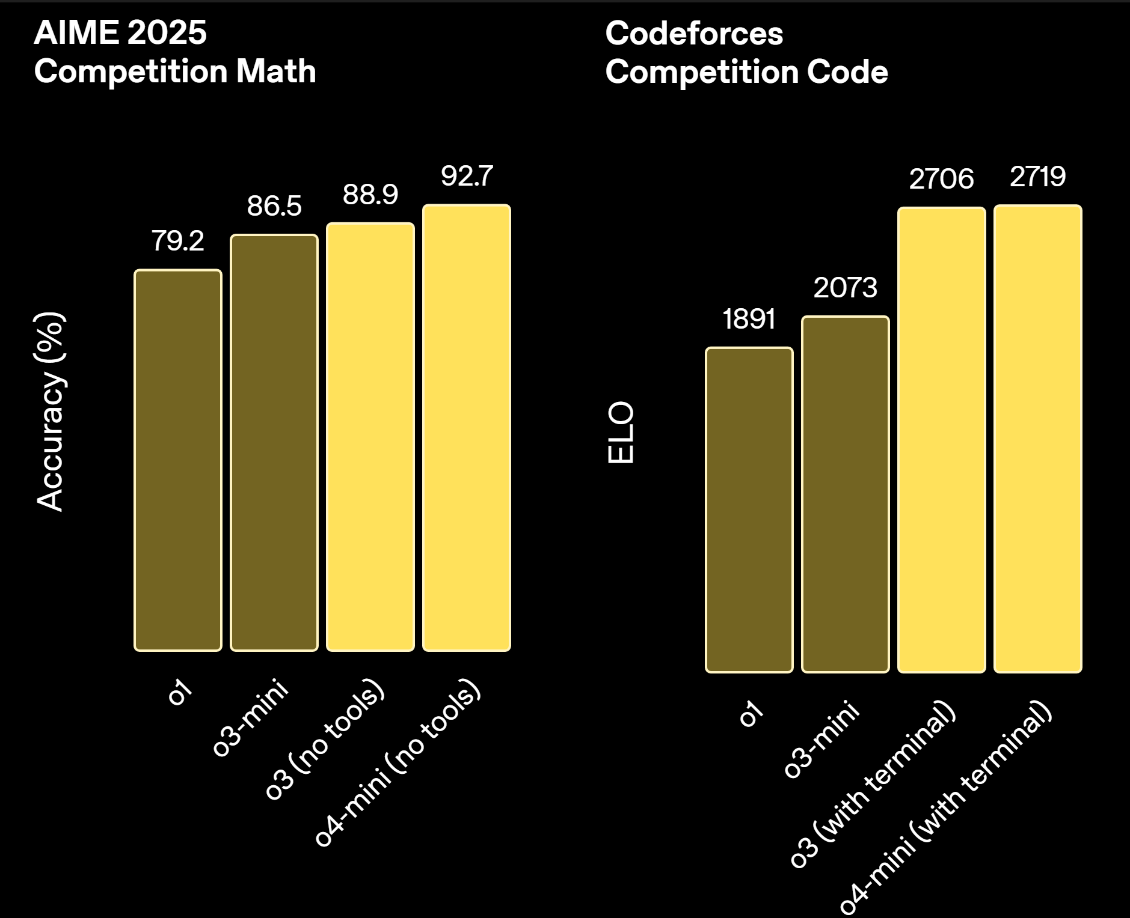
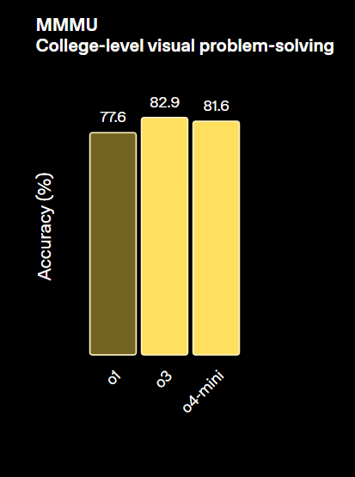
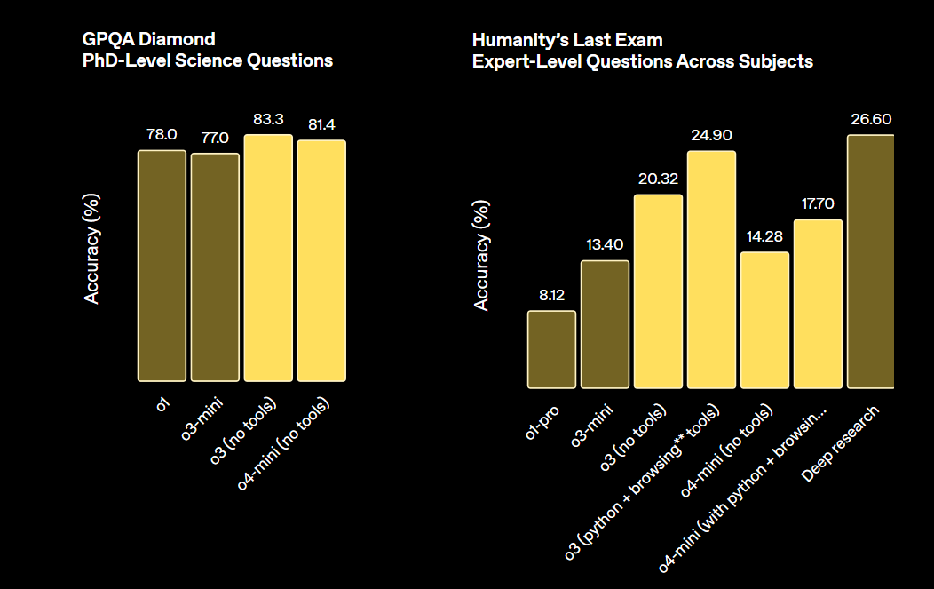
What to Expect: Error Rates and Limitations
ChatGPT Reasoning Model (o1, o3,o4) Benchmarks:

Slide 9
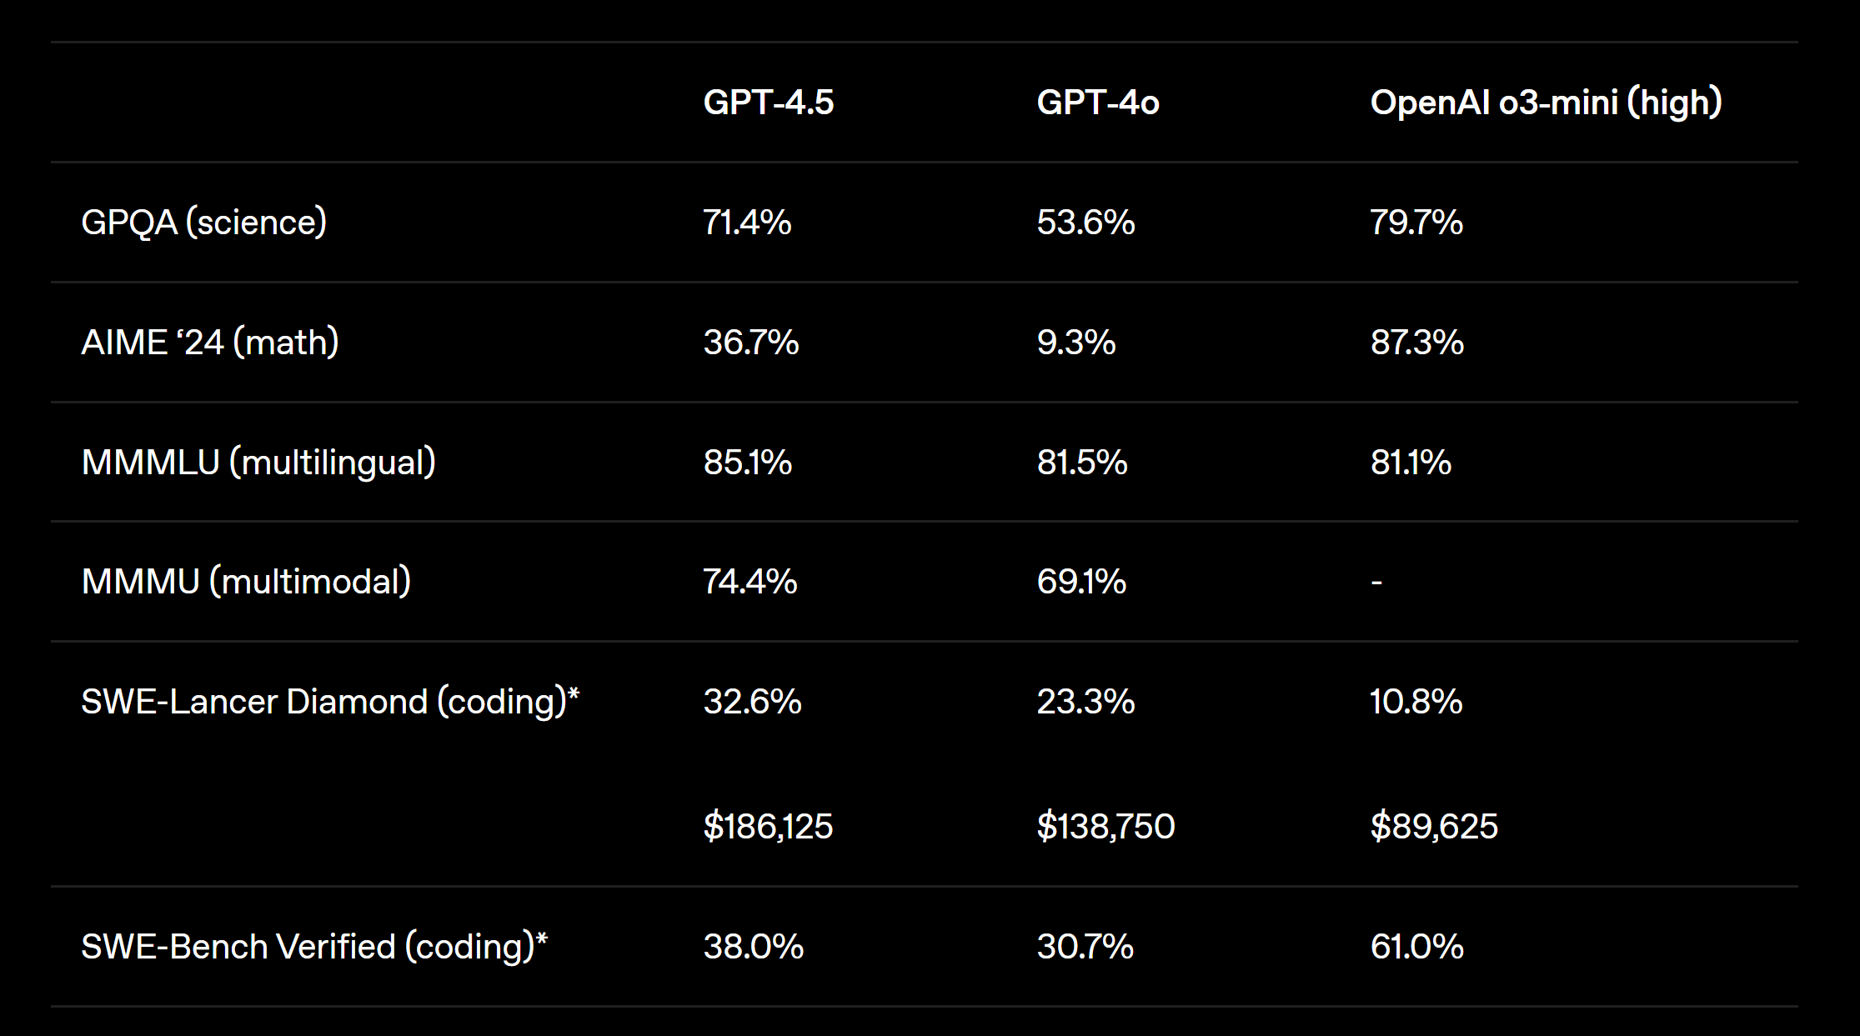
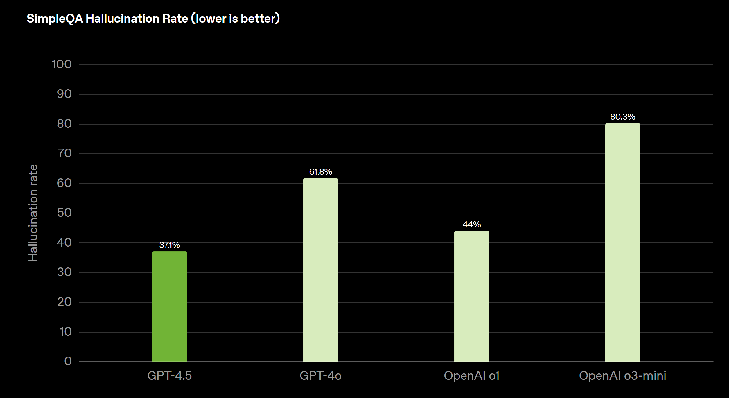
What to Expect: Error Rates and Limitations
ChatGPT Base Model (4o, 4.5) Benchmarks:
All models still struggle with high hallucination rates, especially with non-reasoning models.
Understanding this is essential to capturing value without falling

Slide 10
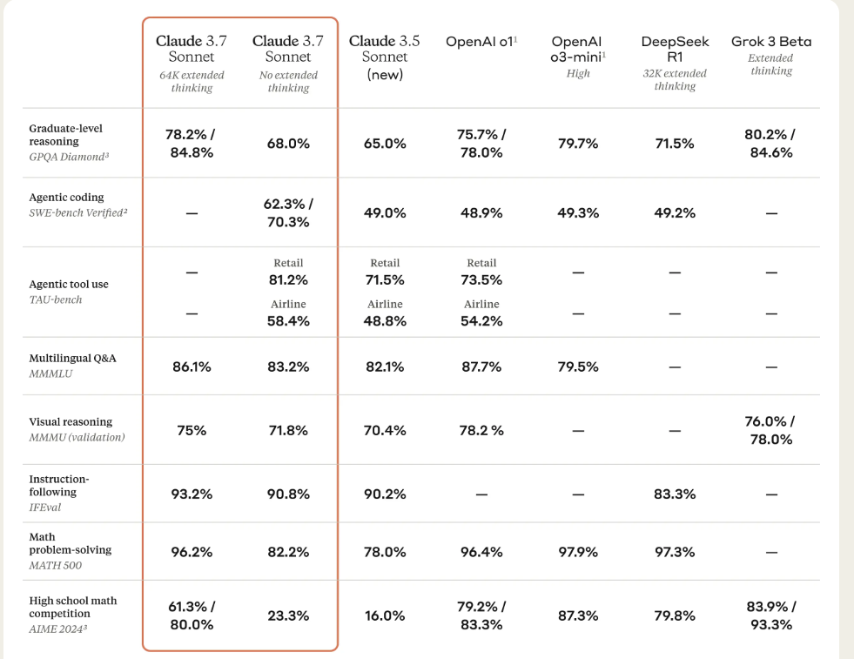
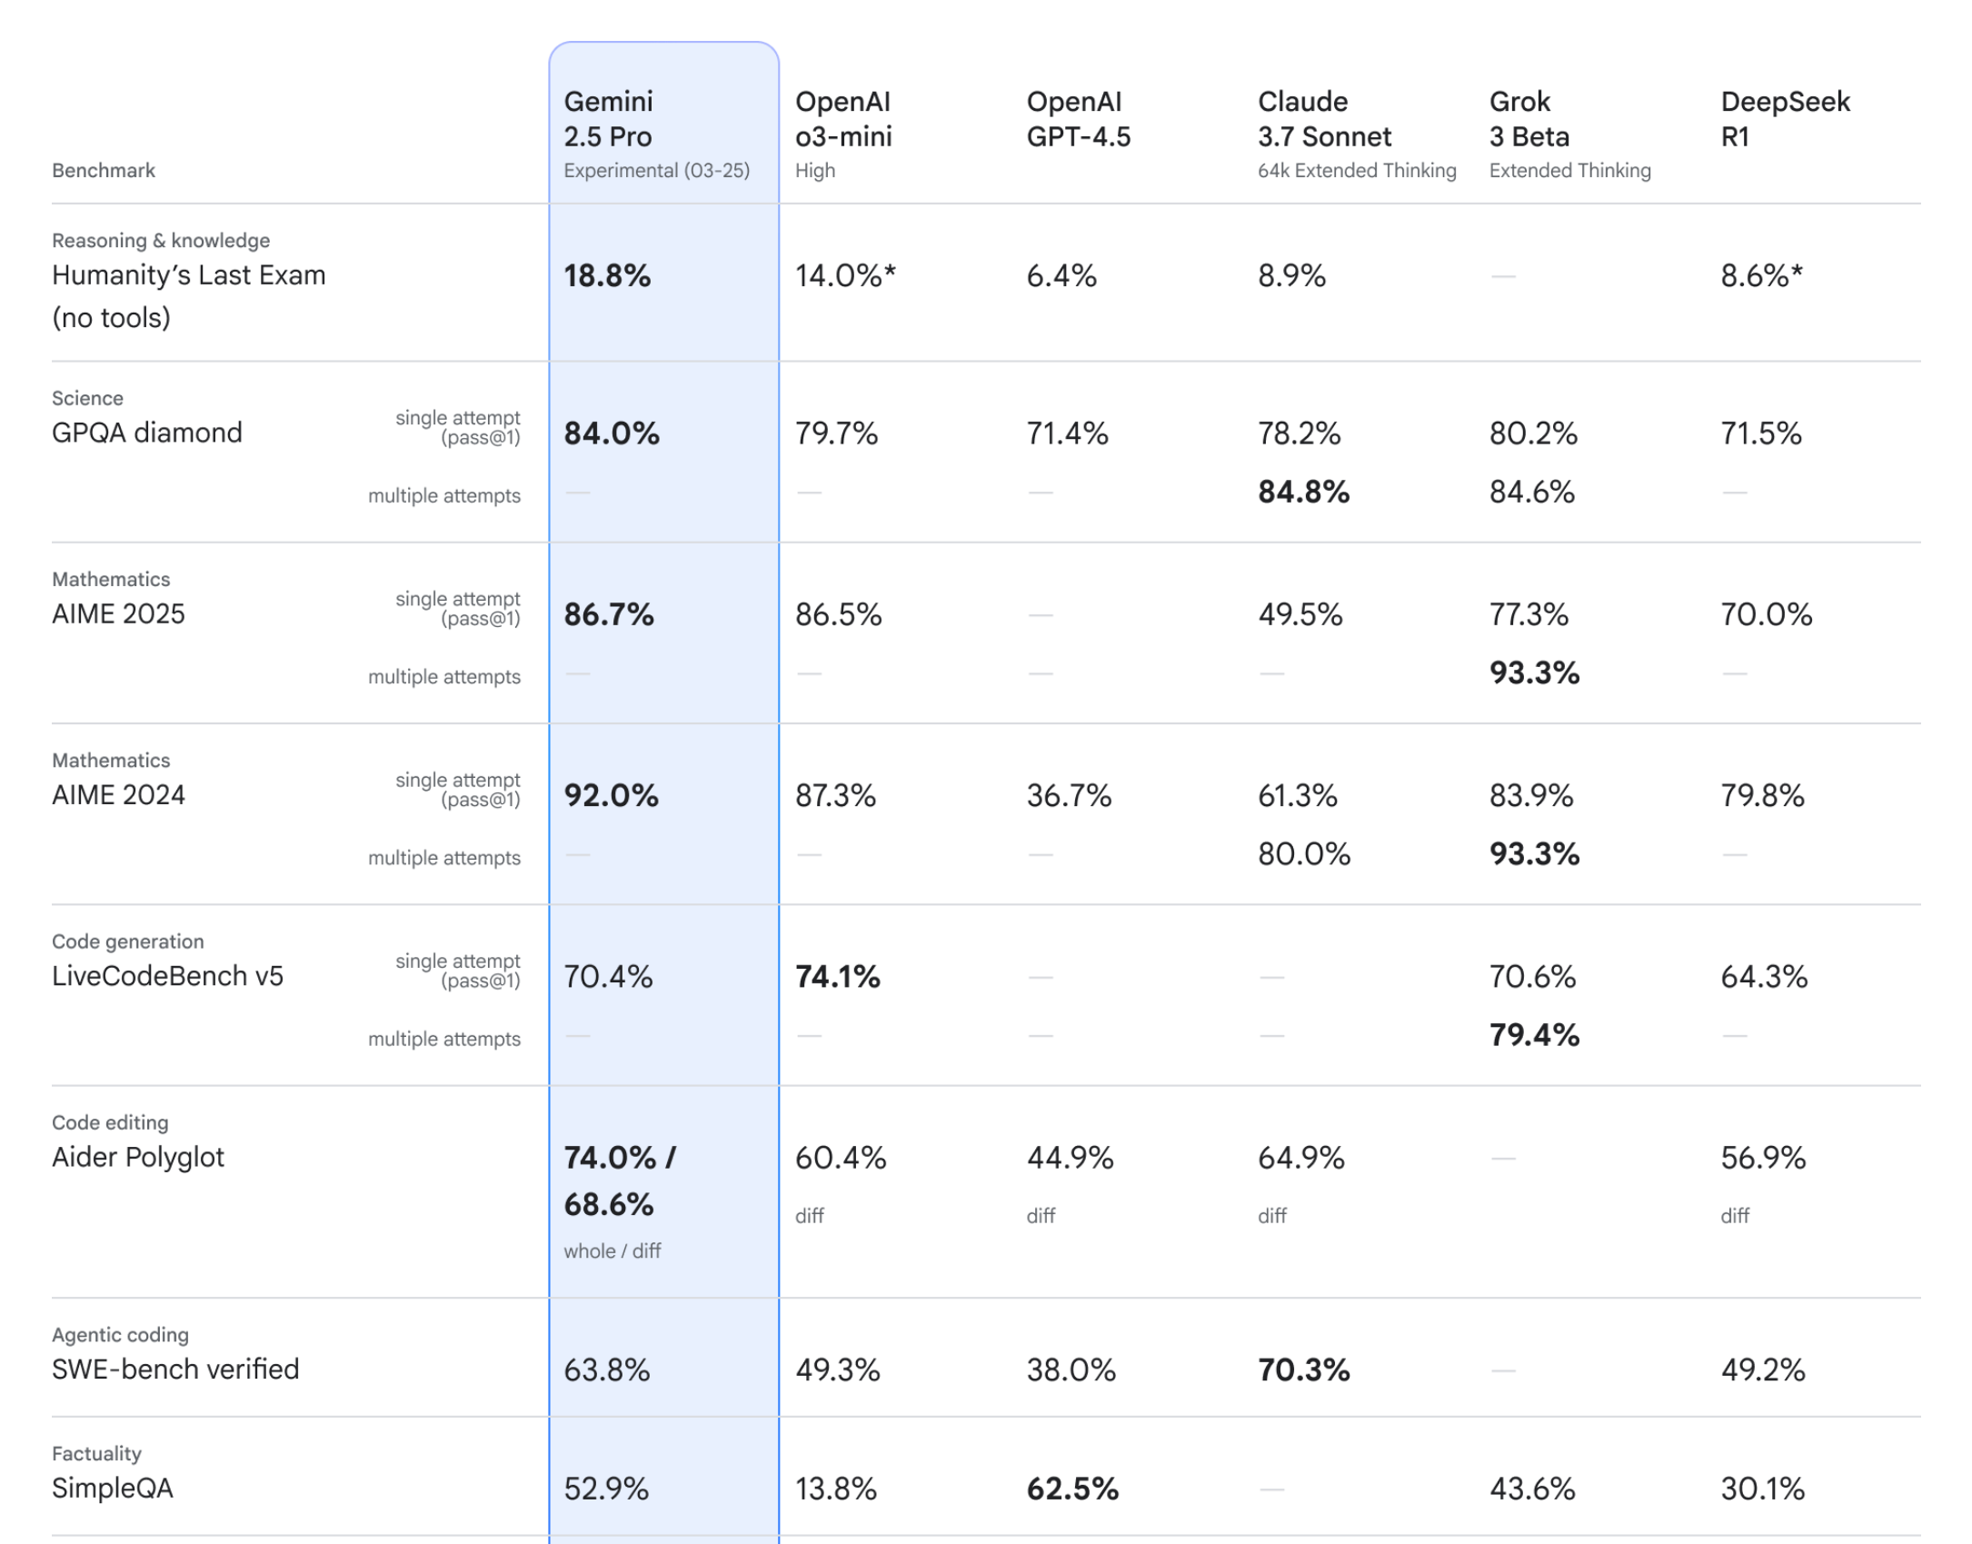
What to Expect: Error Rates and Limitations
Google Benchmarks: Anthropic Benchmarks:

Slide 11
Understanding Tool Use
LLM’s only accept raw images and text input. Most architectures and frameworks have hosted tools that allow their base models to extend their abilities. These come in several common forms:
Data/Context Retrieval
Code Execution
Web Search

Slide 12
How to Capture the Value: H&H Modeling and Geospatial Work
Capturing the value as an H&H Modeler or Geospatial Analyst:
Personalized Software Assistants
Exploratory Agentic Data Analysis (Code Interpreter)
Drafting Python For Local Execution
Making Coding More Efficient and Accessible
Using HTML/Javascript Instead of Spreadsheets for Accessible Fixed Workflows

Slide 13
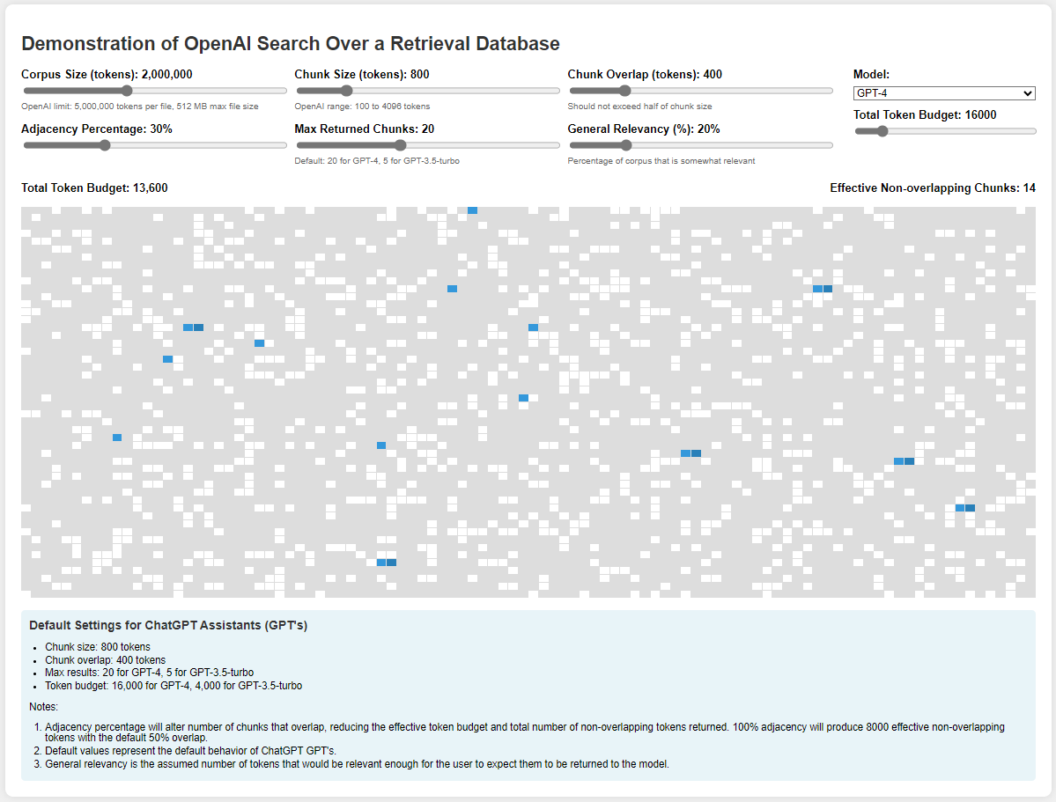
Understanding Context Retrieval from Documents
One rule with LLM’s:
If you don’t see the context directly going to the mode, it might be truncated. Attaching files in ChatGPT can introduce non-transparent limitations on how much text makes it to the actual LLM request.
See this dashboard for more information, and if certain information is critical, always copy/paste it directly into the chat box!
Dashboard: OpenAI Retrieval over Large Dataset

Slide 14
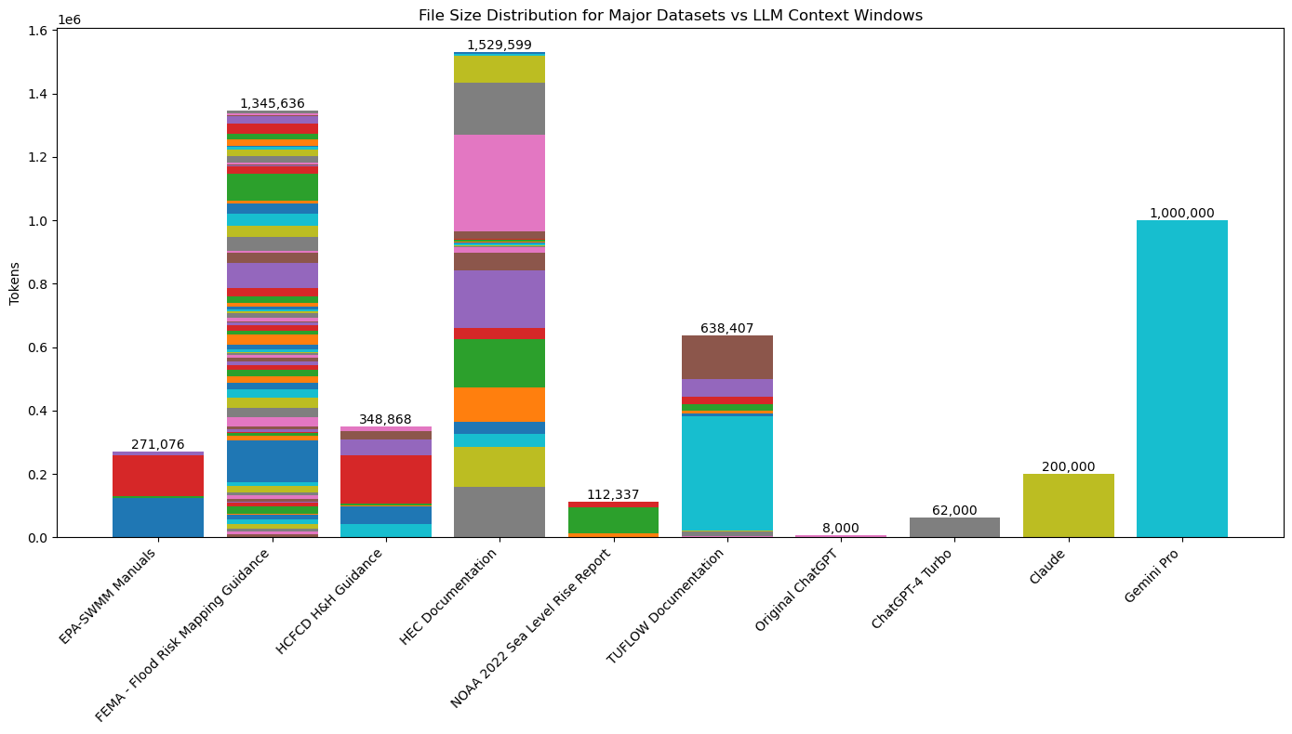
Limitations: Context Window Size
LLM context windows are not large enough to contain large amounts of documentation along with user data. This is improving as current models generally support ~100-200k tokens at minimum.
As context windows get large enough to reason over documentation and user data, code and reports, etc, higher quality outputs will be able to be achieved.

Slide 15
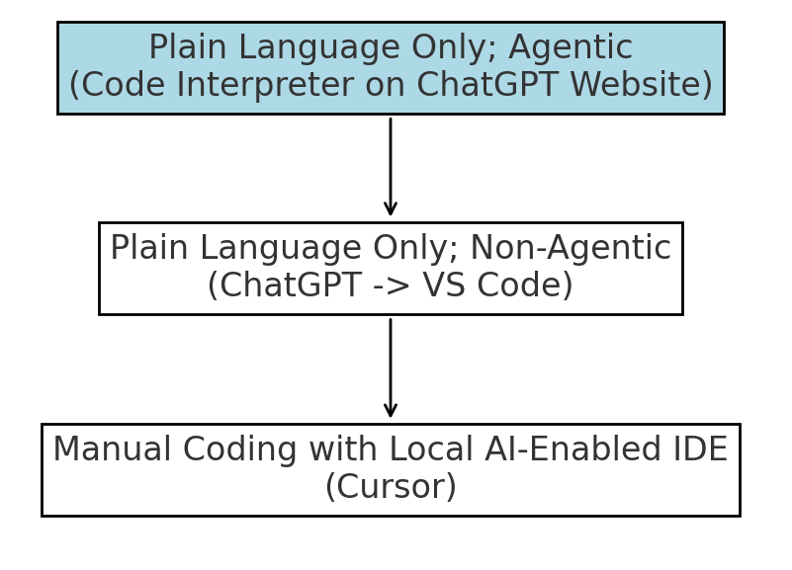
LLM’s Highest Value Application: Writing Code
This workshop will focus on the highest value application of LLMs: Writing Code
3 Levels of code utilization will be explored, from the most passive level that is more appropriate for a beginner, to more advanced local code execution using LLM web interfaces or LLM-enabled integrated development environments.

Slide 18
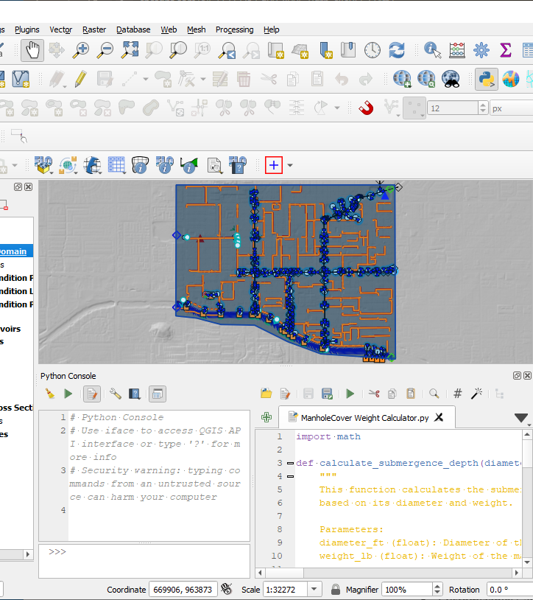
Python Script
Simplify data processing
Efficient for repetitive tasks
ChatGPT makes tools accessible

Slide 19
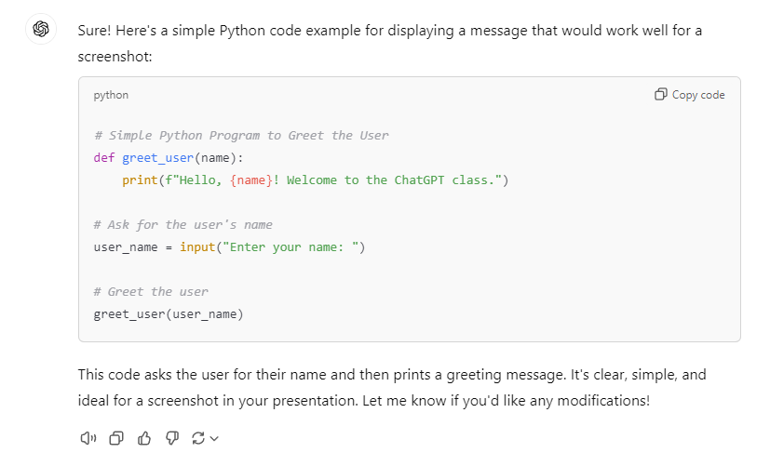
Add Python to your toolbox
GPT
Python
GIS

Slide 20

Python Pros
Open source
No complex compilers
Large community
Excellent documentation
Python Cons
Version control
Cranky path issues
Debugging

Slide 21


Jupyter Notebook
What is Jupyter?
An open-source tool for interactive computing.
Allows you to create and share documents that contain live code, equations.
Key Features:
Interactive code execution in cells.
Rich text formatting with Markdown.
Visualizations using libraries like Matplotlib, Seaborn.
Easy integration with big data tools (e.g., Pandas for data analysis).

Slide 22
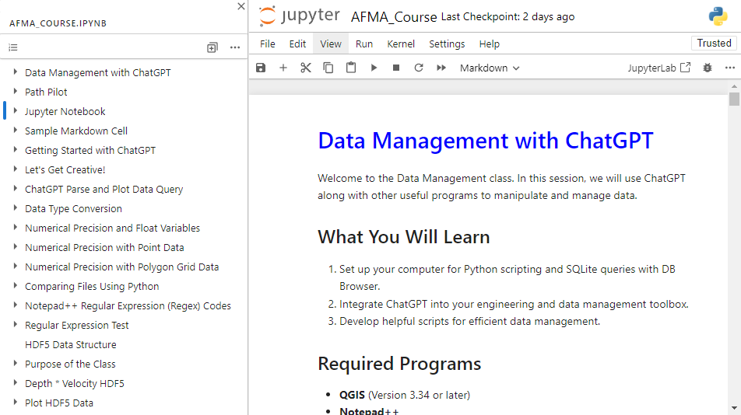
Workshop Notebook
Instructions on Markdown cells.
Code examples on code cells.
Add cells for your code.
Shift Enter to run cell.
If you double-click inside a Markdown cell. Run it to reset it.

Slide 23
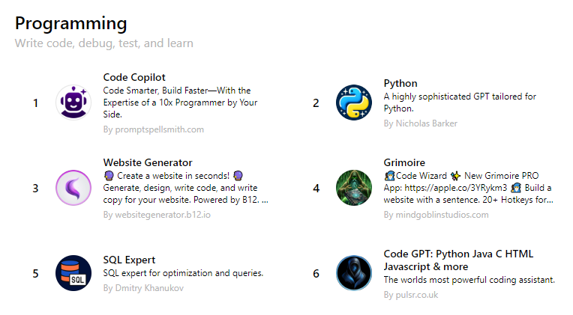
Publicly Available GPTs
HEC Commander GPTs
HEC-RAS
HEC-HMS
Writing and Research
Scholar GPT
Write For Me
Video and PDF summarizer
Data Analyst

Slide 24
ChatGPT Memory
Initial use
Establish a memory.
Identify programs and versions.
Provide feedback on responses.
May not get the point.
Buggy code.
Use along with StackExchange or Reddit to find better solutions
Use over time
Fewer bad responses.
Learns your style and customs.
Limits responses to your program versions.
Adjusts feedback to your preferred language.
Snarky – funny – professional …

Slide 25
ChatGPT Errors
Vague questions
Knowledge cutoff
Simplify language
Break down communication to simple steps
Fact check and error check
Feed correct information back to ChatGPT.

Slide 26
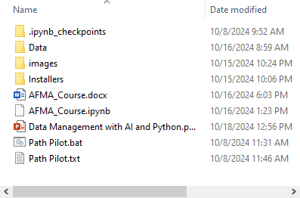
Workshop Package
Add package to an easy to access directory.
Be careful using OneDrive.
Start with the workbook.
Internet access is Guest wifi
Setup or log in to an OpenAI account

Slide 27
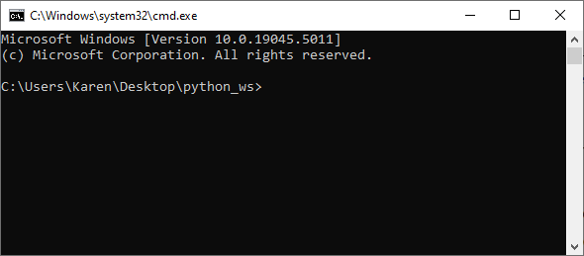
Path Pilot
Path Configuration: Automatically configures environment paths for QGIS, Python, and Jupyter, ensuring all tools are ready for use.
Automatic Detection: Detects and launches Jupyter Notebook from the working directory where the .bat file is located.
Simplified Workflow: Ensures that all required paths are correctly set up, eliminating manual configuration steps.

Slide 28
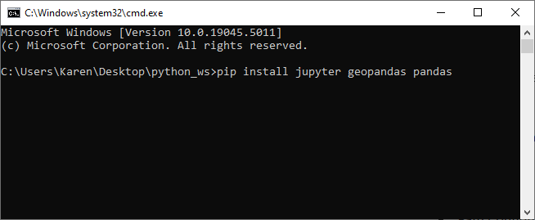
Path Pilot Terminal
Path Pilot uses cmd.exe to run commands.
It is a python terminal and a QGIS shell.
ChatGPT can provide commands and instructions for specific tasks.
We’ll mainly use it to install Python modules and run the Jupyter Notebook.

Slide 29
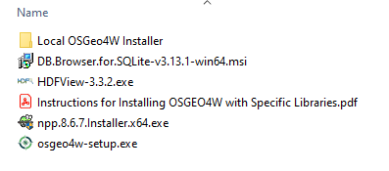
Workshop Installers
QGIS with local installer
Notepad++ installer
DB Browser
HDFView

Slide 30
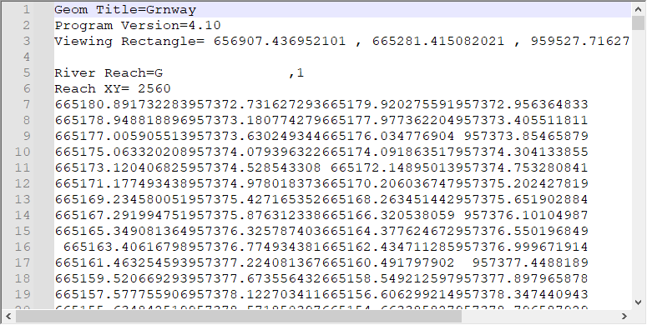

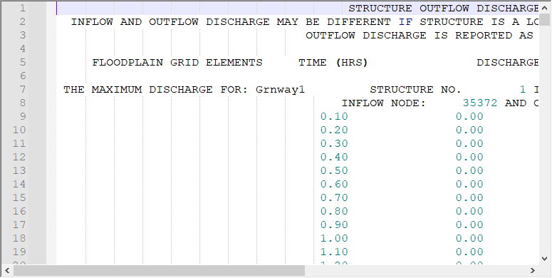
Data Samples
Text data
ASCII
UTF-8
UNIX
CSV

Slide 31
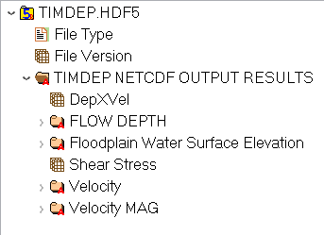
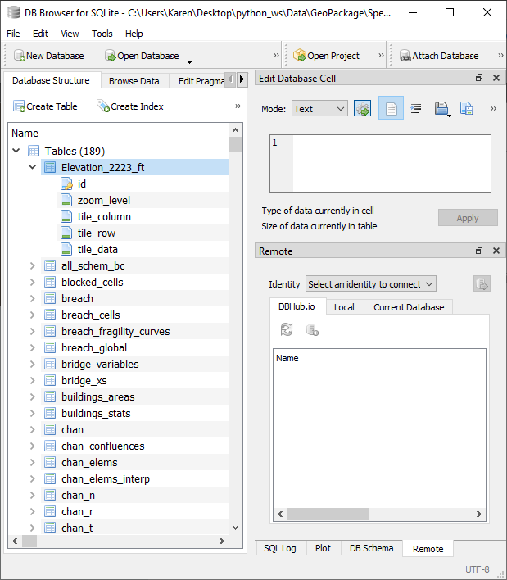
Data Samples
Binary Data
hdf5
gpkg
geodatabase

